Slide 1
FOOD HUB business STUDY
By Arsalaan Saiyed

Slide 2

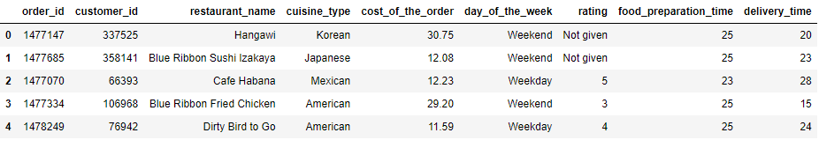
Business overview
The FoodHub app allows the restaurants to receive a direct online orders from a customers. The app assigns a delivery person from the company to pick up the order after it is confirmed by the restaurant. The delivery person then uses the map to reach the restaurant and waits for the food package. Once the food package is handed over to the delivery person, he/she confirms the pick-up in the app and travels to the customer's location to deliver the food. The delivery person confirms the drop-off in the app after delivering the food package to the customer. The customer can rate the order in the app. The food aggregator earns money by collecting a fixed margin of the delivery order from the restaurants.
The data given to us is from an app from a food aggregator company FoodHub for restaurants in New York City. The food aggregator company has stored the data of the different orders made by the registered customers in their online portal. The data sample contains information related to the orders.
Data Sample:

Slide 3
Objective
The number of restaurants are increasing as there is an increasing demand as lot of students and busy professionals rely on those restaurants due to their hectic lifestyles. Online food delivery service is a great option for them. It provides them with good food from their favorite restaurants. A food aggregator company FoodHub offers access to multiple restaurants through a single smartphone app.
The objective of this document is to display the extracted insights from the data and showcase the identified areas of improvement.
Analysis Methodology:
Understanding the raw data
Univariate Exploratory analysis of individual variables
Multivariate Exploratory analysis and identifying correlations
Following the analysis we showcase key findings and insights and recommended some improvements that can drive business decision that help boost revenue and enhance customer experience.

Slide 4
Data information
Given data consists of 1898 orders.
Note:
There is no missing data
Some of the orders are not rated hence marked as ‘Not given’
There are 14 types of cuisine the customers have ordered
Duration for the data is not specified.

Slide 5
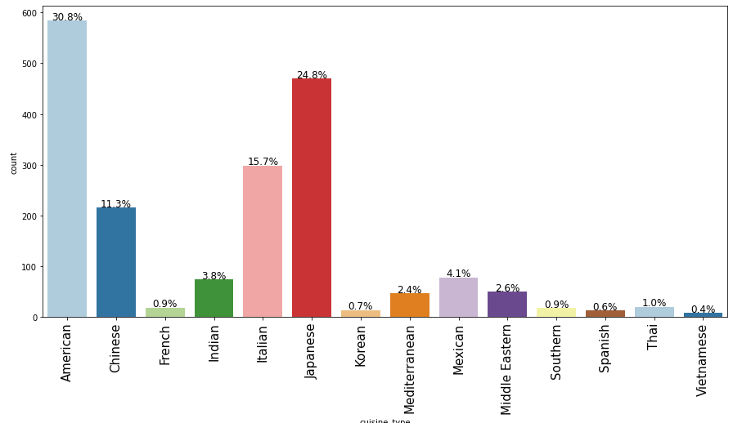
Exploratory Data Analysis – CUISINE TYPE
Observation:
As observed the top 5 most popular cuisines are:
American 30.8%
Japanese 34.8%
Italian 15.7%
Chinese 11.3%
Mexican 4%
Note:
Similar popularity ratio is maintained throughout the week

Slide 6
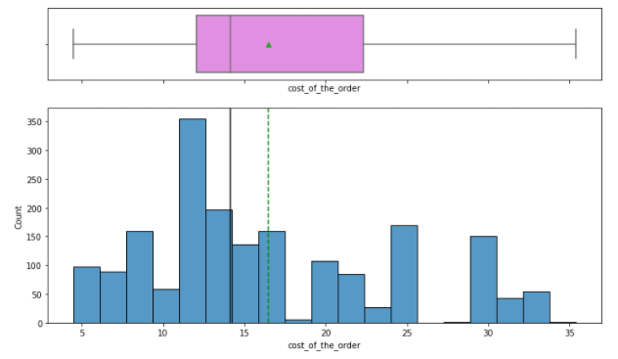
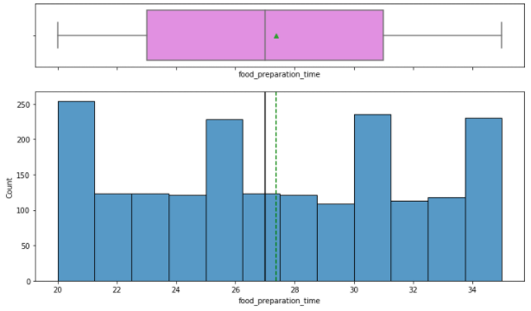
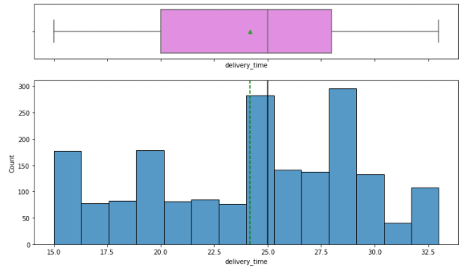
Exploratory Data Analysis – Cost of order, Food preparation & delivery time
Cost of order
Food preparation time
Delivery time
Observation:
Mean is higher than median indicating right skew.
Mean value around 16.5 dollars and median of 14.14 dollars per order
Observation:
Mean is higher than median indicating right skew.
Mean value around 27.4 mins and median of 27 mins per order
Observation:
Mean is lower than median indicating left skew.
Mean value around 24.16 mins and median of 25 mins per order

Slide 7
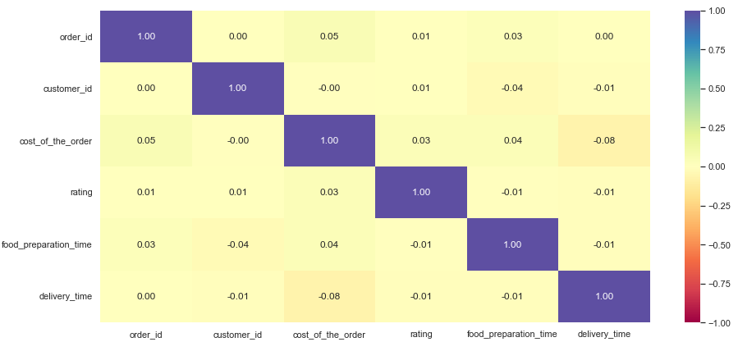
Exploratory Data Analysis - Correlation matrix
Observations:
No significant correlation between any variables in the given data i.e. numerical v/s numerical relations are not strong.
Lets analyze the categorical data.
Note:
Given heat map is for the orders for which ratings were given but, there is no difference in correlation between those orders where rating is given and those where it is not.

Slide 8
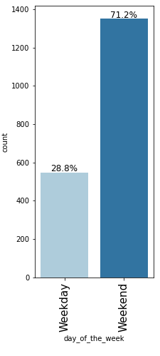
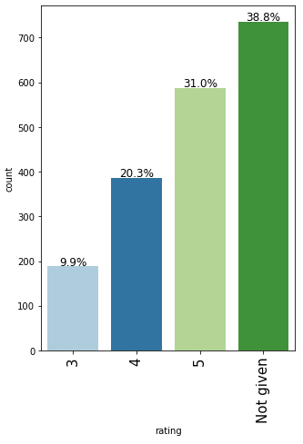
Exploratory Data Analysis – Univariate Categorical
Day of the week
Rating
Observation:
As we can see, most of the orders are placed are over the weekend.
Only 28.8% of orders were placed on the weekday
71.2 % of the orders were placed over the weekend
Observation:
38.8% of orders were not rated
31% of orders – rated 5
20.3 % of orders – rated 4
9.9% of orders – rated 3

Slide 9
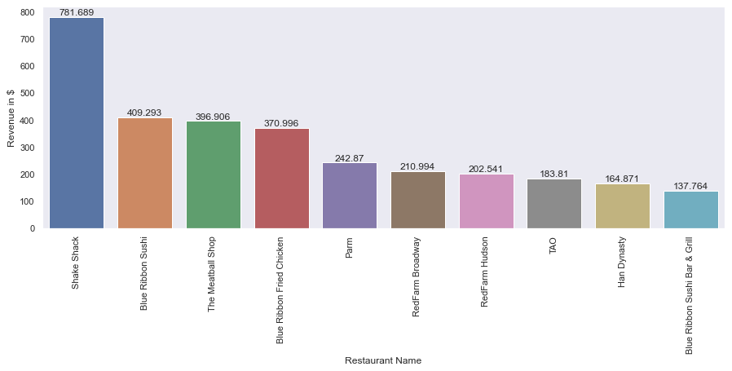
Exploratory Data Analysis – Univariate Categorical
Restaurant Name
Observation:
85% of all revenue is made by the top 5 cuisine types.
Top 5 earning restaurant serve American or Japanese cuisines.

Slide 10
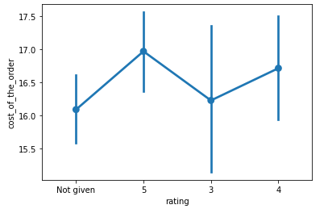
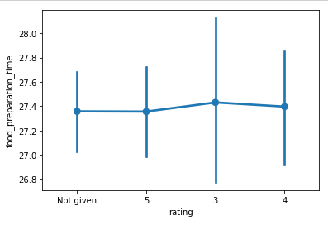
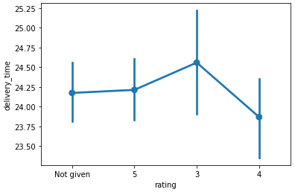
Multivariate Data Analysis - Rating
Cost of order
Food preparation time
Delivery time
Observation:
3 is the most given rating to orders ranging from $15-$17.
4 & 5 rating is given to orders with higher costs.
Orders w/ lower costs were not rated.
Observation:
Most orders that were rated poorly if the food preparation time exceeded 27.8 mins.
Higher ratings or no rating don’t seem to be strongly correlated to food preparation time.
Observation:
Most orders that were rated poorly if the delivery time exceeded 24 mins.
Positive ratings (4 or 5) were given for faster deliveries i.e. delivery time lesser than 24 mins.

Slide 11
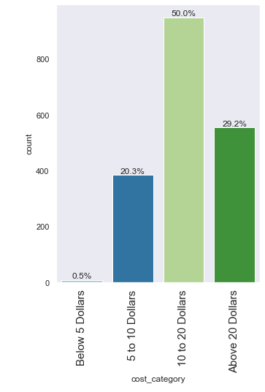
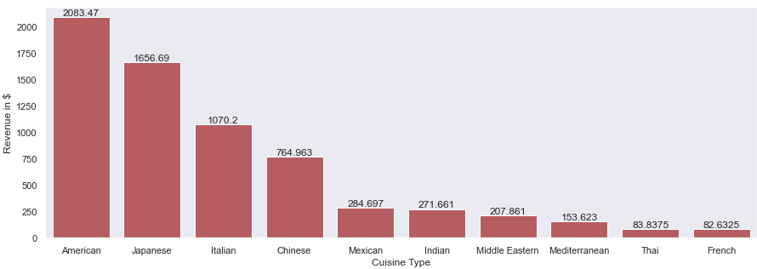
Foodhub’s business model & performance
Business Model:
The company charges the restaurant 25% on the orders having cost greater than 20 dollars and 15% on the orders having cost greater than 5 dollars.
In the given data the total revenue generated by FoodHub on all orders was $6,166.3 which is 19.69% of the cost of all orders placed.
Performance:
20.3% of the orders are between 5 to 10 dollars.
50% of the orders are between 10 to 20 dollars.
29.2% of the orders are above 20 dollars.
0.5% of orders are below 5 dollars.
85% of all revenue is made by the top 5 cuisine types.

Slide 12
Conclusion
71.2% of the orders are placed on weekends, which means there is capacity for more orders during the weekdays.
Order costs ranging from 10-20 dollars make up for 50% of all orders.
American, Japanese and Italian are the most popular and profitable cuisines.
The factors that driving FoodHub’s revenue are:
Number of orders raised through FoodHub.
Cost of orders.
Customer service and their experience.
38.8% of the orders are not rated which means that performance of orders and restaurants is not completely accurate.
10.54% of the orders take longer than 60 minutes to get to the customer.

Slide 13
recommendations
Goal 1 – Increase Number of Orders:
There are always new people moving in to the city so provide discounts for new customers on their first orders through FoodHub.
Suggest kitchens for in-demand restaurants to stay open for longer hours. If our data included date and time stamps we could analyse which cuisines/restaurants are popular during which hours of what day of the week and target boosting those orders.
Target ads and promotional offers for American, Japanese and Italian (the top 3 cuisines)
Goal 2 – Increase Earning on Orders:
Add two additional ranges of order cost that such that we make more than 15% per order on orders lying between 5-10 dollars and 10-20 dollars. The suggested model would have made ≈11% more profit.
Previous Model |  | Suggested Model
Range | FoodHub Revenue | FoodHub Revenue
5-10 | 15% | 15%
10-20 | 15% | 20%
20+ | 25% | 25%
Goal 3 – Improve Customer Service and Experience:
Rating plays a important role in customer service, it gives appropriate representation of the quality of services provided. Hence, incentivise customers to rate the orders by giving them discounts on delivery on their next order.
Display expected delivery time based on customer location and restaurant location to avoid receiving low rating based on delivery time. Delivery time can be reduced by allotting more delivery vehicles or not accepting orders in areas that take more than 20mins to reach the customer. Restaurants should consider preparation time and delivery time when accepting orders and aim to not exceed the 60min mark to complete the orders.

